Slide 1

Earth Observation
Laura Giustarini 13/07/2022

Slide 2
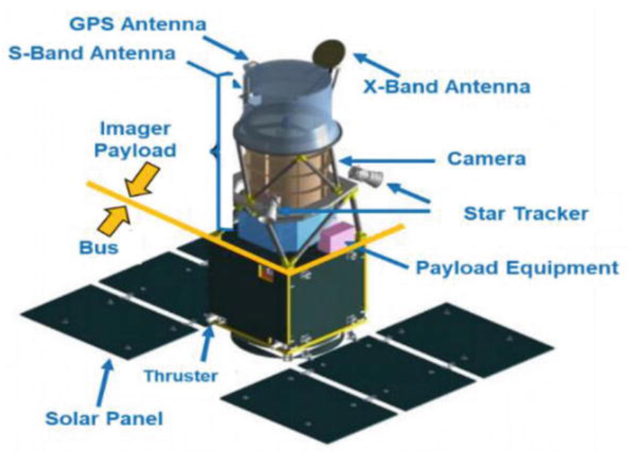
Definitions (1/3)
Earth Observation (EO):
The process of acquiring observations of the Earth’s surface via instruments mounted on different platforms:
One platform may carry several instruments.
Instruments (sensors):
Passive
Active
Platforms (Buses):
Satellites
Aircrafts
Drones

Slide 3
Definitions (2/3)
Remote Sensing (RS):
The acquisition of information about an object or phenomenon without making physical contact with the object: the term can be applied to acquiring information about the Earth and other planets.

Slide 4
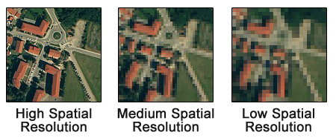
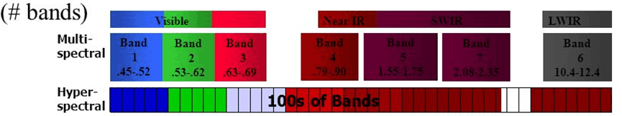
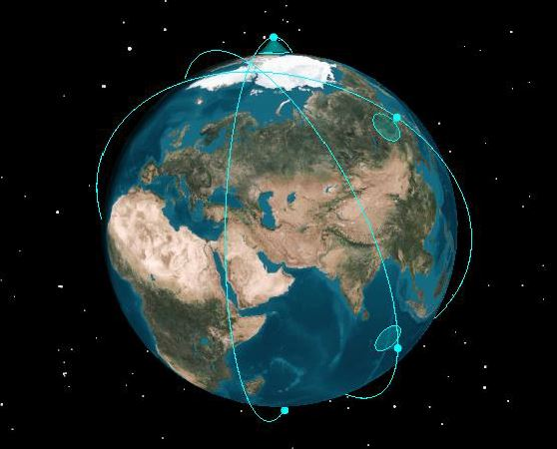
Definitions (3/3)
Spatial resolution:
Image resolution can be measured in several ways; one of them the physical dimension that represents a pixel of the image.
Spectral resolution:
Spectral resolution describes the amount of spectral detail in a band. High spectral resolution means its bands are more narrow. Whereas low spectral resolution has broader bands covering, each of them, more of the spectrum.
Revisit time:
the time elapsed between subsequent observations of the same area of interest

Slide 5
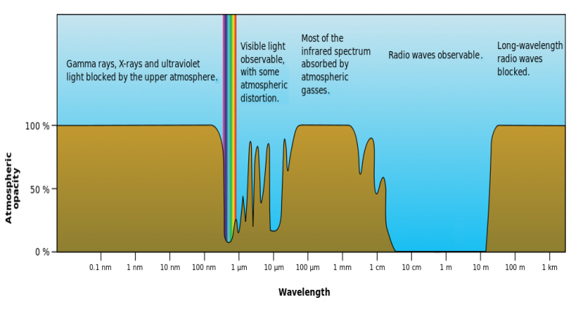
Earth atmosphere
The electromagnetic transparency of the atmosphere allows observations in:
The visible spectrum (~0,39 – ~0,70 μm)
Part of the infrared spectrum (~0,70 – ~14 μm)
The radio wave range (~1 cm – ~11m)
(Source: http://commons.wikimedia.org/wiki/File:Atmospheric_electromagnetic_opacity.svg)

Slide 6
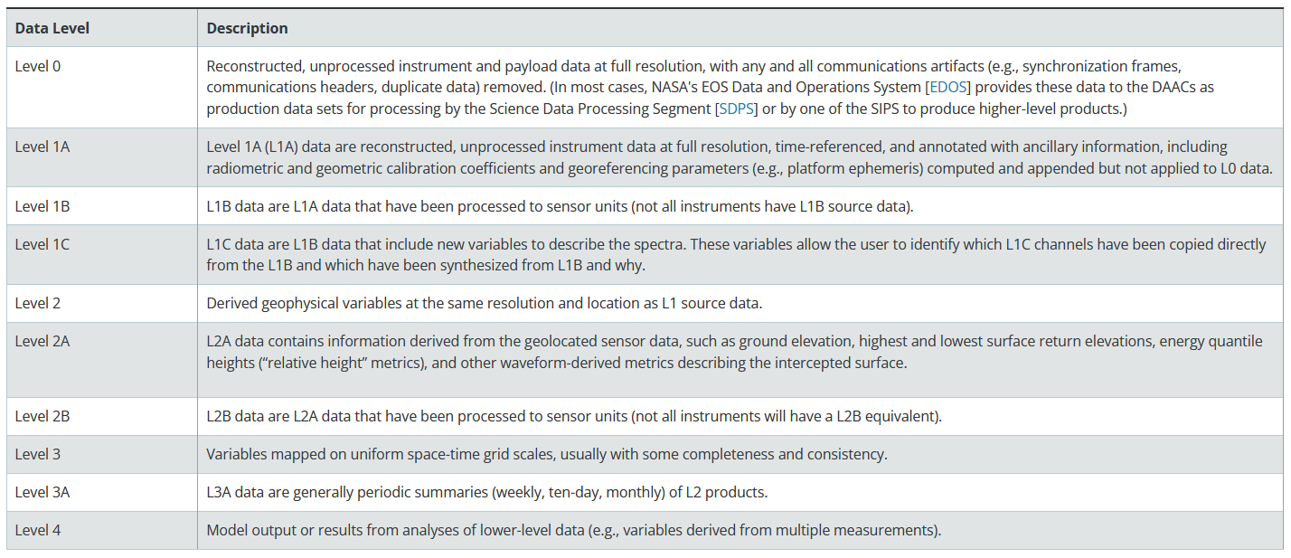
Levels
Several satellite products are processed at various levels ranging from Level-0 to Level-4. Level-0 products are raw data at full instrument resolution. At higher levels, data are converted into more useful parameters and formats.

Slide 7
PASSIVE IMAGERY
Instruments are designed to detect electromagnetic emissions from the components of the Earth’s surface & atmosphere.
Passive imagery is possible depends on the day/night cycle and can be degraded or blocked by cloud cover.
Types of passive imagery:
Panchromatic
Multi-spectral
Pan-sharpened
Hyper-spectral

Slide 8
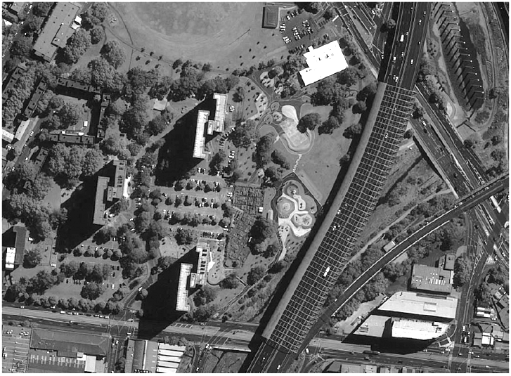
Panchromatic images
They represent a measure of light intensity over a broad range of the electromagnetic spectrum: this allows the collection of more energy which lead to a higher spatial resolution (up to 30 cm in resolution for the best commercially available satellite instruments).
A panchromatic image by visible sensors collects for example the light intensity coming from the observed scene in the full visible spectrum. Visible satellite imagery which relies on sunlight reflected up to the satellite can only be obtained during daylight. Here an example displayed in shades of grey.
A panchromatic image by thermal infrared sensors is correlated with the temperature of the object emitting that radiation. Because IR is constantly emitted by the Earth and by clouds, it is possible to obtain IR satellite imagery even when the scene is not illuminated by the sun.
Panchromatic image (Source: http://www.cscrs.itu.edu.tr/assets/downloads/PleiadesUserGuide.pdf)

Slide 9
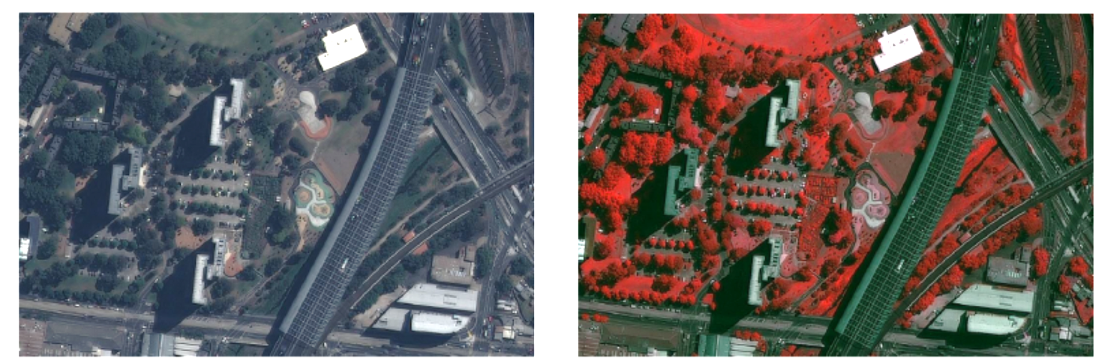
Multi-spectral images
They represent a measure of light intensity in several narrow bands of the electromagnetic spectrum. This will result in lower spatial resolution.
A common example of multi-spectral images is the production of “natural colour” images (see figure on the left) by the combination of measurements in 3 bands of the visible spectrum, in the same way as is done in classical cameras.
Multi-spectral images are not restricted to the visible spectrum: measurements can be done in the infrared (IR) fields, ultraviolet (UV), microwave, etc. The figure on the right presents an example of a "false colour" image, combining the green band (displayed in blue), the red band (displayed in green) and a near infrared band (displayed in red). This visualisation combination allows highlighting the presence and health of the vegetation: healthy vegetation creates chlorophyll which reflects near-infrared energy, and appears in darker red on the image.
Panchromatic image (Source: http://www.cscrs.itu.edu.tr/assets/downloads/PleiadesUserGuide.pdf)

Slide 10
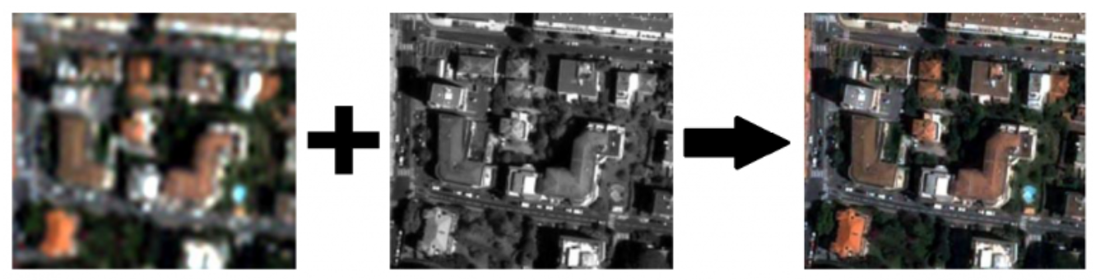
Pan-sharpened images
Pan-sharpening is the process of merging multi-spectral images with panchromatic images to provide high resolution coloured images.
Improved spatial resolution (from pan-chromatic image)
Improved spectral resolution (from multi-spectral image)
Multi-spectral image
Pan-chromatic image
Pan-sharpened image

Slide 11
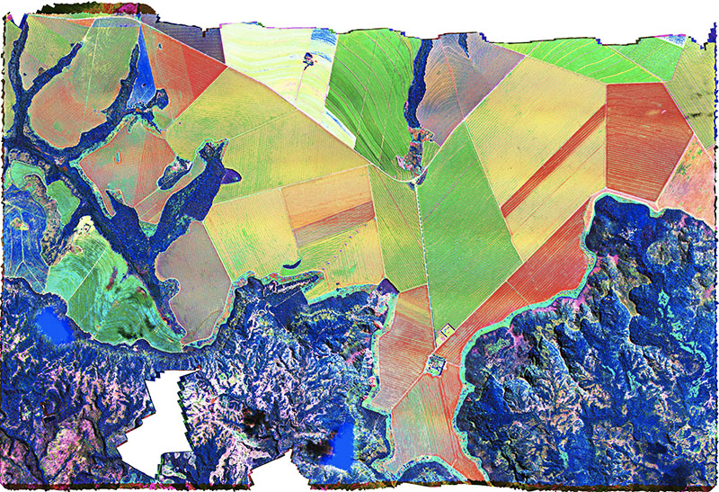
Hyper-spectral images
They represent a measure of light intensity in a nearly-continuous spectrum, acquiring light intensity on a large number (typically a few tens to several hundred) of contiguous narrow spectral bands.
The high spectral resolution of a hyperspectral imager allows for detection, identification and quantification of surface materials, as well as inferring biological and chemical processes.
Different corn varieties

Slide 12
ACTIVE IMAGERY
Instruments are composed of a transmitter that sends out a specific electromagnetic signal and of a receiver to capture the interaction of the signal with the Earth’s surface.
Active imagery do not depend on solar illumination.
Types of active imagery:
Synthetic Aperture Radar (SAR)
Light Detection And Ranging (Lidar)
Radar altimeter
Radar scatterometer

Slide 13
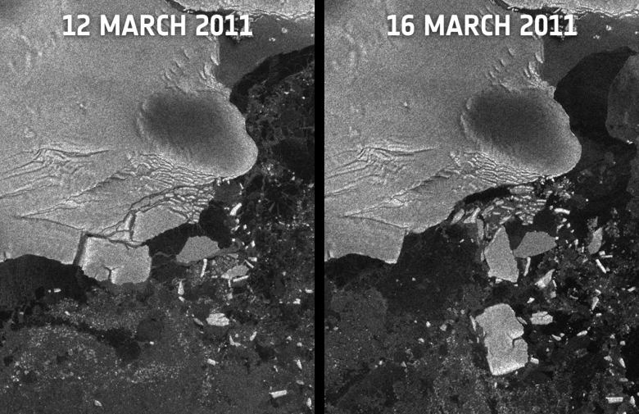
SAR (1/3)
This instrument transmits electromagnetic pulses towards the Earth’s surface where they are reflected or scattered by the surface features. The instrument’s antenna can detect and record the return pulses. The intensity of the return pulse and the time it takes to arrive back at the antenna are used to generate SAR imagery.
It is insensitive to the day/night cycle and most of the time to the meteorological conditions, including clouds (shorter wavelength signals such as X-band can be degraded by heavy intense rain cells).
Example of SAR imagery for monitoring formation of Icebergs (Source: ESA ENVISAT)

Slide 14
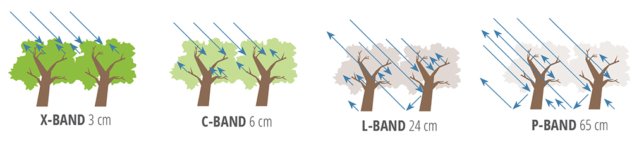
SAR (2/3)
Wavelength determines how the radar signal interacts with the surface and how far a signal can penetrate into a medium, such as a forest or other land cover types such as soil and ice.
An X-band radar (wavelength of ~3 cm) has very little capability to penetrate into broadleaf forest, and mostly interacts with leaves at the top of the tree canopy.
An L-band signal (wavelength of about ~24 cm) penetrates into a forest and gest more interactions between the radar signal and large branches or tree trunks.

Slide 15
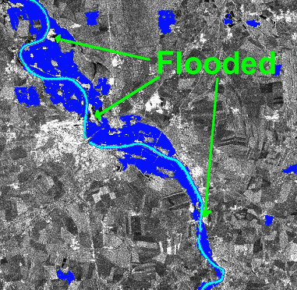
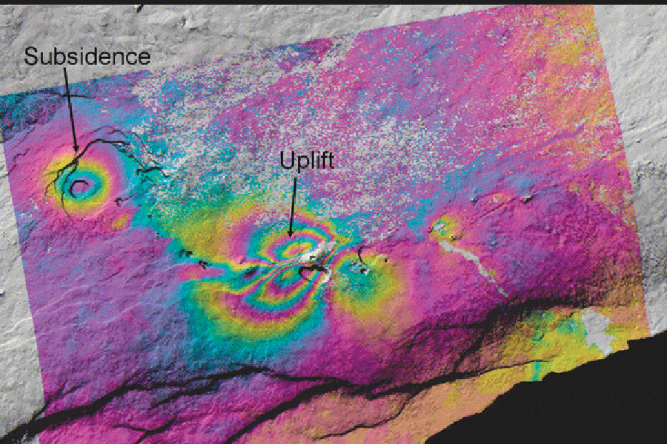
SAR (3/3)
Applications include:
Flood mapping (day/night and through clouds)
Deformation mapping: earthquakes, landslides
DEM creation

Slide 16
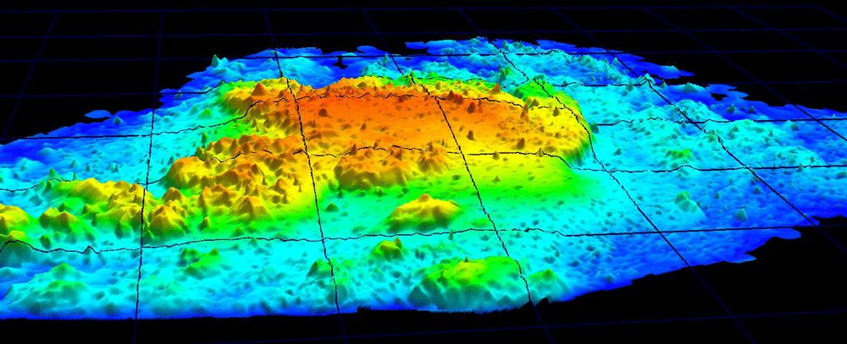
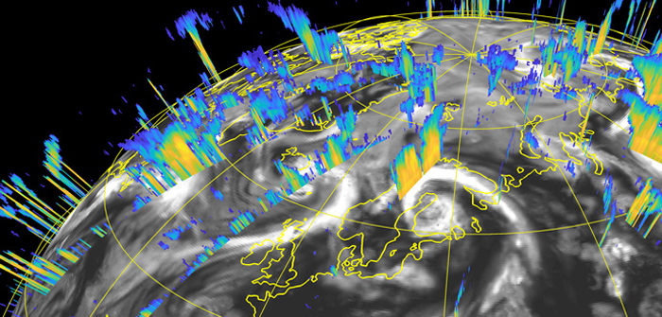
LiDAR (Light Detection And Ranging)
It uses the same principle as SAR but works in the IR, visible or UV wavelengths.
Lidars are used for precise measurement of topographic features, monitoring growth or decline of glaciers, profiling clouds, measuring winds, studying aerosols and quantifying various atmospheric components.

Slide 17
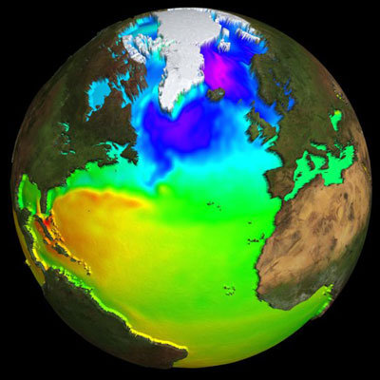
Radar Altimeter
It uses the ranging capability of radar to measure the surface topography profile along the satellite track. They provide precise measurements of a satellite's height above the ocean by measuring the time interval between the transmission and reception of very short electromagnetic pulses.
Parameters that may be inferred are time-varying sea-surface height (ocean topography), the lateral extent of sea ice and altitude of large icebergs above sea level, as well as the topography of land and ice sheets, and even that of the sea floor, sea-surface wind speeds and significant wave heights.
Altimetry-derived mean dynamic topography (Source: http://www.esa.int/spaceinimages/Images/2005/06/Altimetry-derived_mean_dynamic_topography; Copyright CLS)

Slide 18
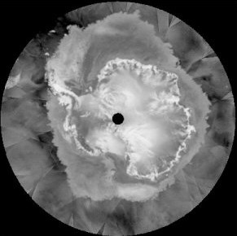
Radar Scatterometer
A radar scatterometer is a microwave radar sensor used to measure the reflection or scattering effect produced while scanning the surface of the Earth from an aircraft or a satellite. It provides a measure of wind speed and direction near the sea surface.
Radar scatterometer data are important sources of information for Numerical Weather Prediction (NWP), oceanography and climate studies.
Radar scatterometers can also provide information such as sea ice cover. Sea ice typically reflects more of the radar energy emitted by the sensor than the surrounding ocean, so it appears brighter in a radar scatterometer image.
Rdar scatterometer image of Antarctica, 19 July 2003, QuikSCAT satellite (Source: https://nsidc.org/cryosphere/seaice/study/active_remote_sensing.html)

Slide 19
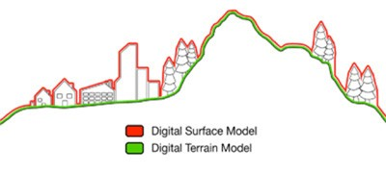
3D MODELS
EO data can also be processed in order to produce 3D models of the Earth’s surface.
For example, the technique of across-track SAR interferometry can also be used to generate 3D surface models
Digital Surface Models (DSMs), represent the Earth's surface with all objects on it, Digital Terrain Models (DTMs) which represent the bare ground surface without any objects like plants and buildings. Digital Elevation Model (DEM) is also frequently encountered and can refer to either DSM, DTM or both of them, no convention being commonly accepted.
Distinction between DSM and DTM (Source: geoimage.com.au)

Slide 20
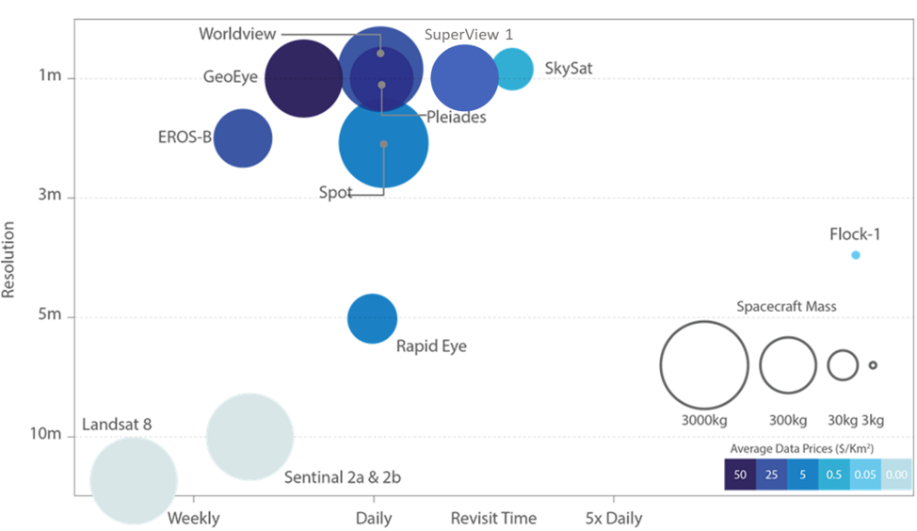
Satellite missions
Spatial Resolution vs Revisit Time for various example satellites (Source: Satellite Applications Catapult 2017, adapted from EO21 Project).

Slide 21
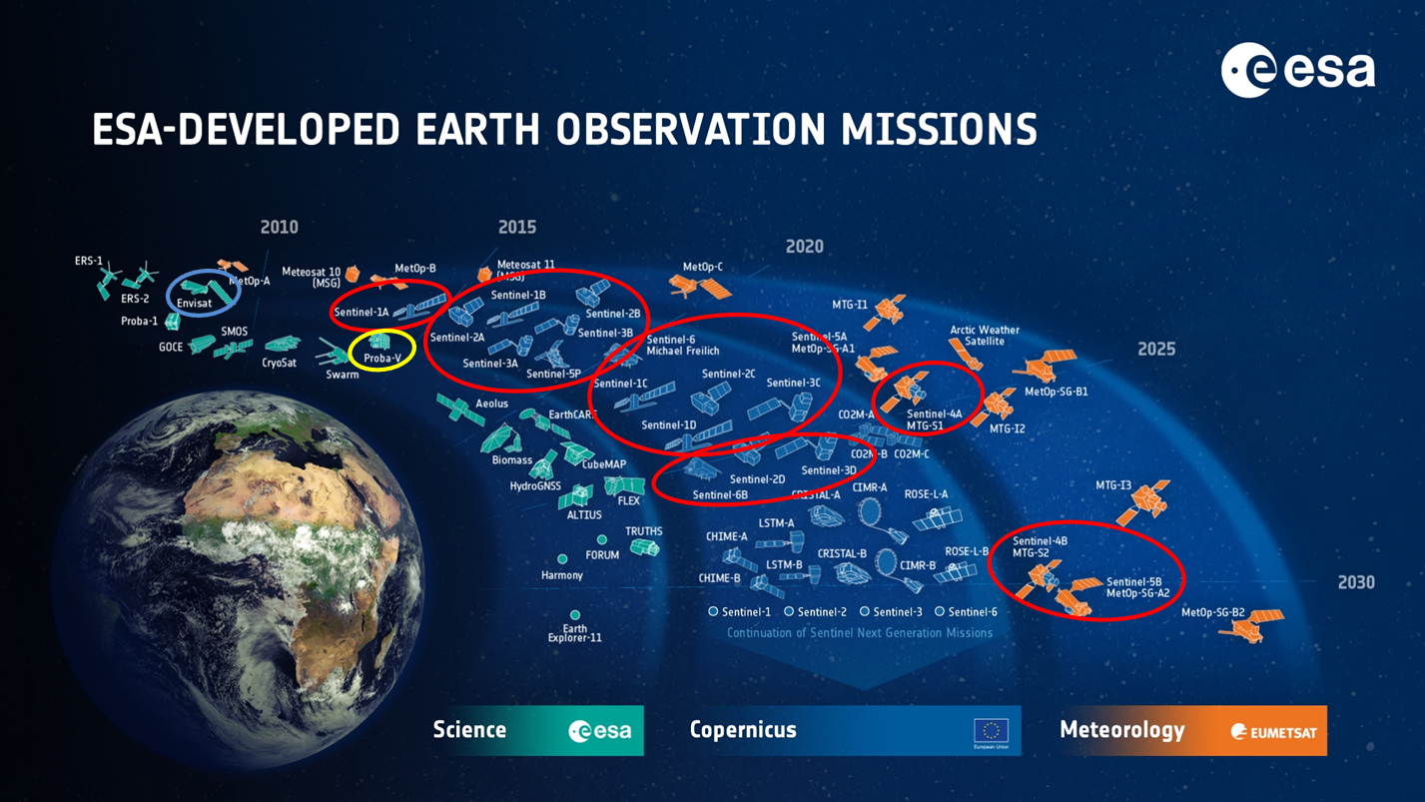
European Space Agency (ESA)

Slide 22
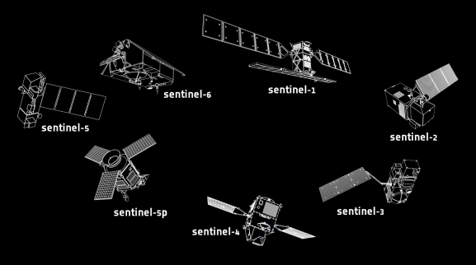
Sentinels (satellites)
Sentinel-1
Objective: Land & Ocean
Instrument: C-band SAR
2 satellites (now one malfunctioning)
9-40 m spatial resolution
6 days revisit time at equator
Sentinel-6
Objective: Sea-surface height
Instrument: Ku/C SAR, radiometer and others
10 days revisit time at equator
Sentinel-2
Objective: Land
Instrument: multi-spectral
2 satellites
10-60 m spatial resolution
5 days revisit time at equator
Sentinel-5
Objective: Air quality
Instrument: passive grating
imaging spectrometer
7.5-50 km spatial resolution
1 day revisit time at equator
Sentinel-3
Objective: Marine
Instruments: radar altimeter and others
3 satellites
300-1200 m spatial resolution
<2 days revisit time at equator
Sentinel-5p
Objective: Gap-filling between Envisat satellite and NASA's Aura mission and the launch of Sentinel-5
Instrument: passive grating imaging spectrometer
7-68 km spatial resolution
1 day revisit time at equator
Sentinel-4
Objective: Air quality
Instrument: passive imaging spectrometer
8 km spatial resolution
60 minutes revisit time at equator

Slide 23
Levels: SAR
Sentinel-1 data are generally distributed at three levels of processing:
Level-0
Level-1
Level-2
For Sentinel-1, Level-1 products are intended for most data users and are generally the most utilized. They can be one of two product types - either Single Look Complex (SLC) or Ground Range Detected (GRD).
Level-1 Single Look Complex (SLC) products consist of focused SAR data, geo-referenced using orbit and attitude data from the satellite, and provided in slant-range geometry.
Level-1 Ground Range Detected (GRD) products consist of focused SAR data that has been detected, multi-looked and projected to ground range using the Earth ellipsoid model WGS84.
Level-2 Ocean (OCN) products can have different components available depending on the acquisition mode.

Slide 24
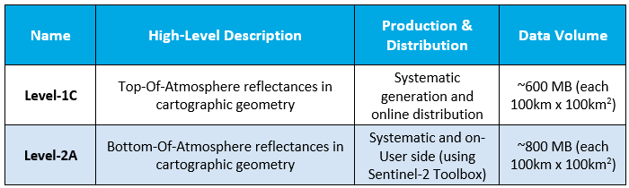
Levels: Multi-spectral
For Sentinel-2, only the Level-1C and Level-2A products are released to users. Level-2A products are generated either using the Sen2Cor processor, or on the User side through the Sentinel-2 Toolbox.

Slide 25
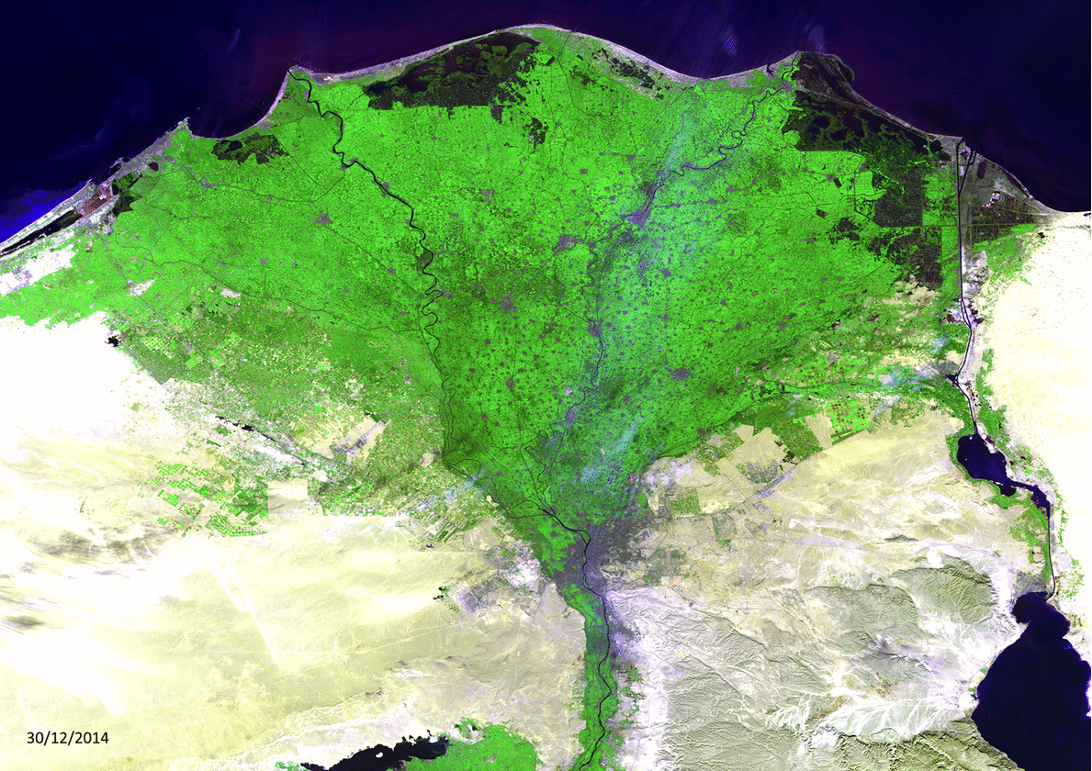
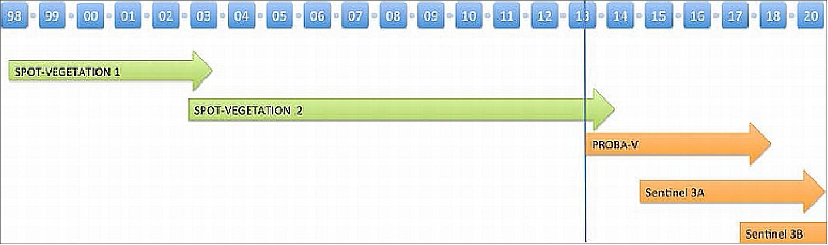
Proba-V (satellite)
Objectives:
land use
worldwide vegetation classification
crop monitoring, famine prediction
food security
disaster monitoring and biosphere studies
Launched on 7 May 2013
Extending the data set of the long-established Vegetation instrument, flown as a secondary payload aboard France's SPOT 4 and SPOT 5 satellites launched in 1998 and 2002 respectively, and serving as a bridge with Copernicus Sentinel-3.
Nile Delta

Slide 26
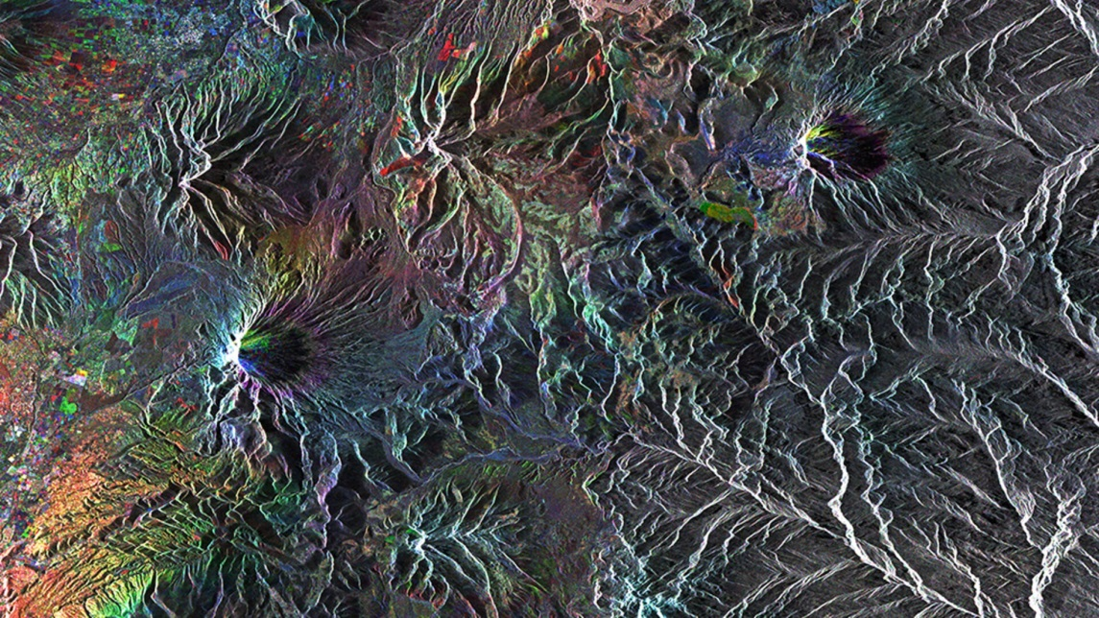
ENVISAT (Satellite)
Objectives:
continuity and enhancement of the observations started with the ERS satellites
extend the range of parameters observed
significant contribution to environmental studies, notably in the area of atmospheric chemistry and ocean studies (including marine biology)
Launched on 1 March 2022
End mission on 8 April 2012 (loss of contact)
Envisat was the largest Earth observation spacecraft ever built with 10 instruments aboard and at 8 tonnes was the largest civilian Earth observation mission ever launched.

Slide 27
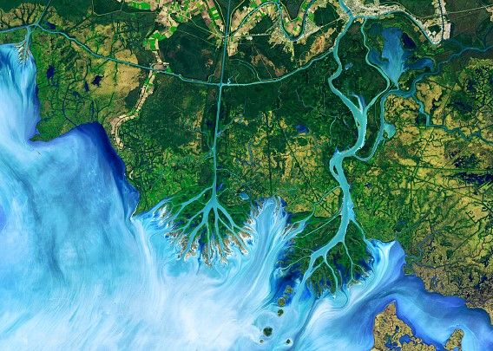
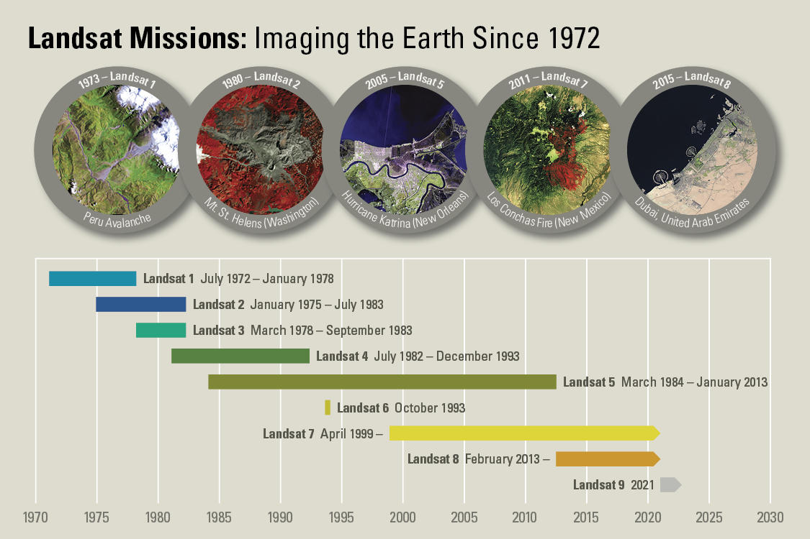
Landsat (satellite) series
A mission by USGS and NASA that represents the world's longest running system of satellites for moderate-resolution optical remote sensing for land, coastal areas and shallow waters.
Its objective is to document land change due to climate change, urbanization, drought, wildfire, biomass changes (carbon assessments), and a host of other natural and human-caused changes.

Slide 28
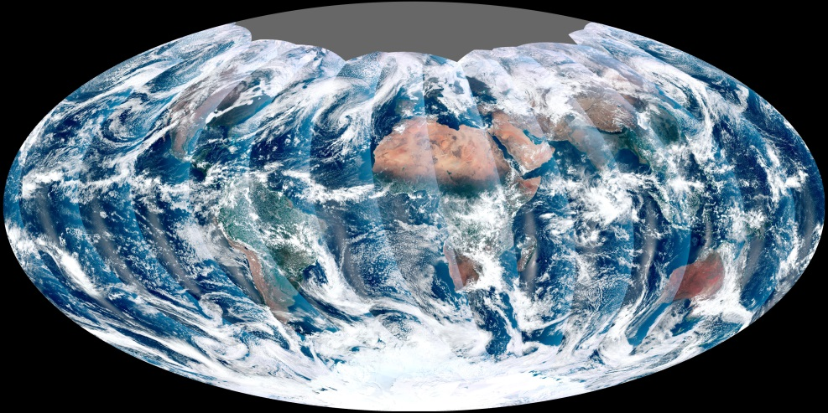
Viirs (instrument)
Objectives:
visible and infrared images of hurricanes
detection of fires, smoke and particles in the atmosphere, such as dust
Cloud properties
Land, ice, sea surface temperature
Vegetation indices
Ocean color and currents
Aerosol characteristics
First global image from Viirs
The Visible Infrared Imaging Radiometer Suite (VIIRS) sensor collects daily visible and infrared images and global observations of the land, atmosphere, cryosphere and oceans.
Flying on the Suomi NPP and NOAA-20 satellite. VIIRS will also be flown on the JPSS-2, -3 and -4 satellites.

Slide 29
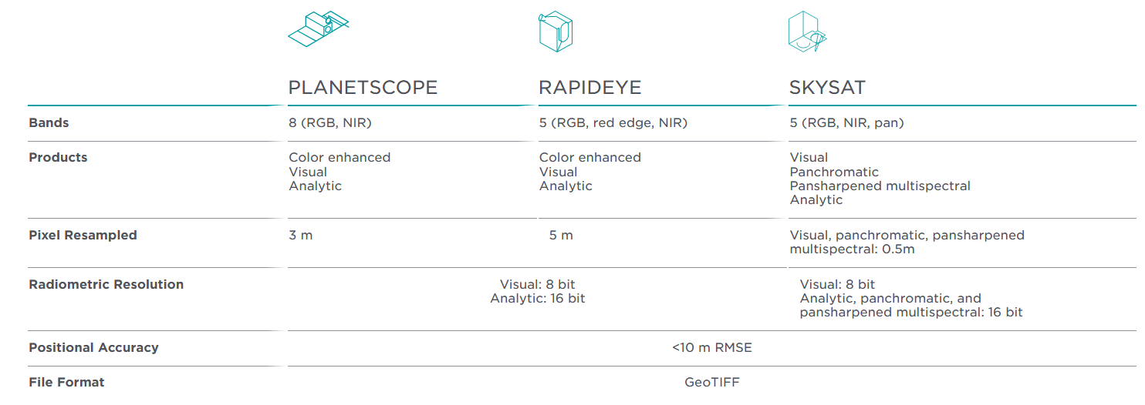
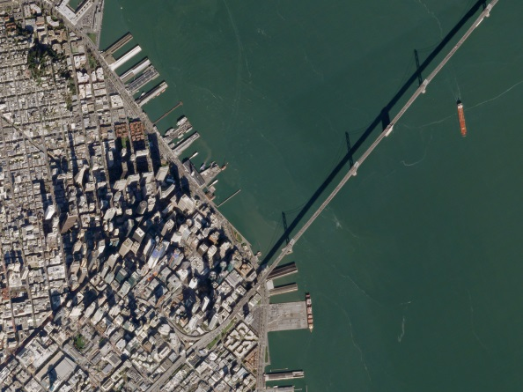
PLANET (commercial provider)
Fleet of over 200 earth imaging satellites

Slide 30
CMEMS (service)
Objectives:
maritime safety
coastal and marine environment
climate and weather forecasting
marine resources users
The Copernicus Marine Environment Monitoring Service (CMEMS) provides more than 150 specific products, derived from a combination of ocean observations (measured in the sea), satellite remote sensed images and ocean forecast models

Slide 31
ERA5 (product)
ERA5 is one of the products available in the service named Climate Data Store (CDS). CDS provides information about the past, present and future climate, on the global, continental, and regional scale.
ERA5 provides hourly estimates of a large number of atmospheric, land and oceanic climate variables for the past The data cover the Earth on a 30km grid and resolve the atmosphere using 137 levels from the surface up to a height of 80km.
ERA5 combines vast amounts of historical observations into global estimates using advanced modelling and data assimilation systems.

Slide 32
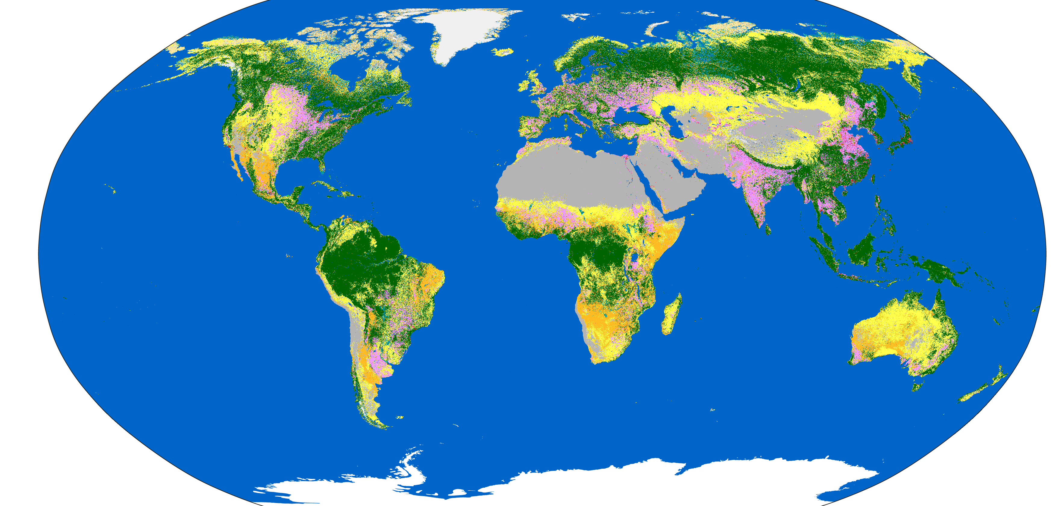
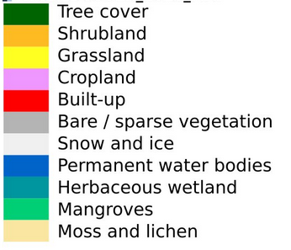
WorldCover (product)
WorldCover provides a new baseline global land cover product at 10 m resolution for 2020 based on Sentinel-1 and Sentinel-2 data.

Slide 33
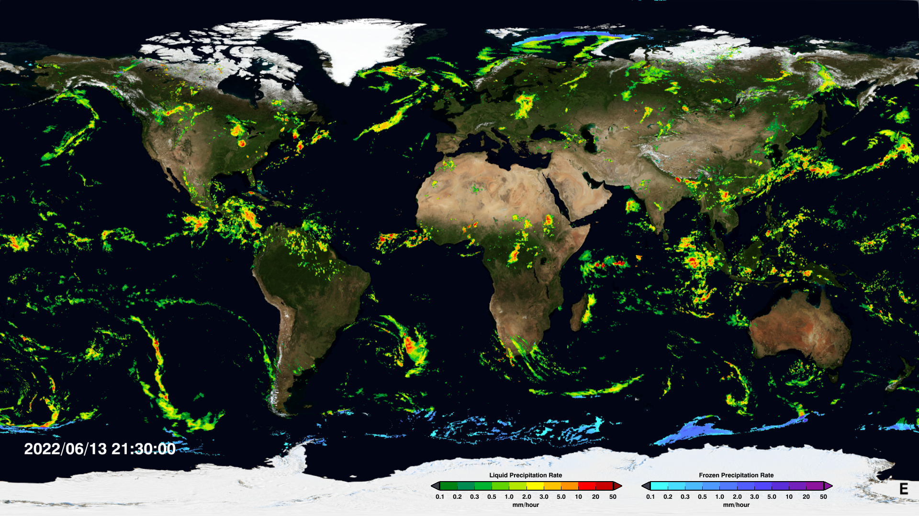
IMERG (algorithm)
The Integrated Multi-satellitE Retrievals for GPM (IMERG) algorithm combines information from the GPM satellite constellation to estimate precipation over the majority of the Earth's surface.

Slide 34
Q&A Thanks for your attention !
Any doubts?

